Slide 1
 | P of Father or Mother to be carrier or affected |  | P child receive d allele from his parent (father or mother)
 | If he is surely Nd. How? From pedigree: He has affected son Or he has affected parent Using DNA finger print if present o | 1 | If parent is affected | 1
 | If he is affected (dd) | 1 | If parent is normal and not NN | 1/2
 | If he is surely NN | 0
 | If he is normal, with normal parents and affected sibling (brother or sister | 2/3
 | No family history, probability of being hybrid is given in text | P

Slide 3
Autosomal/dominant

Slide 4
Recessive mode of transmission
Deny X
Deny Y
Deny homologous X and Y

Slide 5
Dominant mode of transmission
Deny X
Deny Y
Deny homologous X and Y

Slide 6
Chapter 5: Human Genetics

Slide 7
Document 1: Inheritance of Traits
Pedigree allows us to study:
Mode of transmission of disease (dominant/recessive) (gonosomal/autosomal)
Predict genotype of individual
Calculate risk of couple to have a sick child

Slide 8
Dominant Vs recessive
Normal couple (I1 , I2) have a diseased child. The diseased child inherited at least one disease allele from one of his parents where it was masked
Affected couple (I1 , I2) have a normal child. The diseased child inherited at least one normal allele from one of his parents where it was masked so normal allele is recessive with respect to dominant affected allele
Since the disease appears in every generation, and every affected child has at lease one affected parent then the disease can’t be masked so it is dominant
Or

Slide 9
Location of gene
Autosome: Chromosome from 1🡪 22
Sex linked:
Non homologous part of X
Non homologous part of Y
Homologous part of X and Y
Non homologous part of X
Non homologous part of Y
Homologous part of X and Y
 | Male | Female
Autosomal
X linked
Y linked
Homologous X and Y
Table showing ]number of alleles existing in males and females depending on gene location

Slide 10
How to prove the location of gene
The proof of gene location is by elimination.
If it is locate on non homologous part of X, then ….. So it is not the case
If it is locate on non homologous part of Y, then ….. So it is not the case
If it is locate on homologous part of X and Y, then ….. So it is not the case
If it is locate on an autosome, then .... So it is not the case

Slide 11
Determination of gene location if Disease is Recessive

Slide 12
If disease is recessive (X-linked characteristics and denying)
Characteristic
How to Deny
Look for normal father and affected daughter
Every affected girl should have affected father
Every normal boy should have normal mother
Daughter is affected should be X^{d} X^{d} should inherit X^{d} from her father whose genotype should be X^{d}Y who should be affected which is not the case
X linked
Look for affected mother and normal son
mother is affected should be X^{d}X^{d} should give her son X^{d} whose genotype should be X^{d}Y who should be affected which is not the case

Slide 13
If disease is recessive (Y-linked characteristics and denying)
Characteristic
How to Deny
Look for normal father and affected son
If the gene was located on non homologous Y chromosome then son II-1 genotype should be XY^{d} he should have inherited Y^{d} from his father (I-1) who should be also XY^{d} and must be affected which is not the case
Every affected father should have all his sons affected
No females should be affected
Look for affected father and normal son
Y linked
If the gene was located on non homologous Y chromosome then son II-1 genotype should be XY^{d} he should have inherited Y^{d} from his father who should be also XY^{d} and must be affected which is not the case
Look for affected girl
If the gene was located on non homologous Y then no girls should be affected but girl II-1 is affected which is not the case

Slide 14
If disease is recessive (Homologous X and Y characteristics and denying)
Characteristic
How to Deny
Look for normal father and affected son + daughter
Every affected brother and sister should have affected father
Homologous X and Y
If the gene was located on homologous part of X and Y then child II-1 who is affected her genotype should be X^{d}X^{d} should have inherited X^{d} from her father, and the sone II-2 who is affected, his genotype should be X^{d}Y^{d} then he should inherit Y^{d} from his father, so father’s genotype should be X^{d}Y^{d} and must be affected which is not the case

Slide 15
How to deny that the gene is autosomal in case of recessive disease
Since only males are affected then the disease is more probable to be sex linked, it is neither autosomal nor on homologous X-Y segment
Case 1: Only males are affected
Case 2: If given in text, case of lethal allele, example: embryo with 2 diseased alleles is aborted
autosomal, since affected children should be “dd”, then shouldn’t be alive which is not the case.

Slide 16
Sum up: If disease is recessive
Homologous X and Y
X linked
Y linked
Every affected girl should have affected father
Every normal boy should have normal mother
Every affected father should have all his sons affected
No females should be affected
Every affected brother and sister should have affected father
Characteristic
Look for normal father and affected daughter
If the gene was located on non homologous Y chromosome then son II-1 genotype should be XY^{d} he should have inherited Y^{d} from his father (I-1) who should be also XY^{d} and must be affected which is not the case
Daughter is affected should be X^{d} X^{d} should inherit X^{d} from her father whose genotype should be X^{d}Y who should be affected which is not the case
How to Deny
If the gene was located on non homologous Y chromosome then son II-1 genotype should be XY^{d} he should have inherited Y^{d} from his father who should be also XY^{d} and must be affected which is not the case
If the gene was located on homologous part of X and Y then child II-1 who is affected her genotype should be X^{d}X^{d} should have inherited X^{d} from her father, and the sone II-2 who is affected, his genotype should be X^{d}Y^{d} then he should inherit Y^{d} from his father, so father’s genotype should be X^{d}Y^{d} and must be affected which is not the case
Look for affected mother and normal son
mother is affected should be X^{d}X^{d} should give her son Xd whose genotype should be X^{d}Y who should be affected which is not the case
If the gene was located on non homologous Y then no girls should be affected but girl II-1 is affected which is not the case.

Slide 17
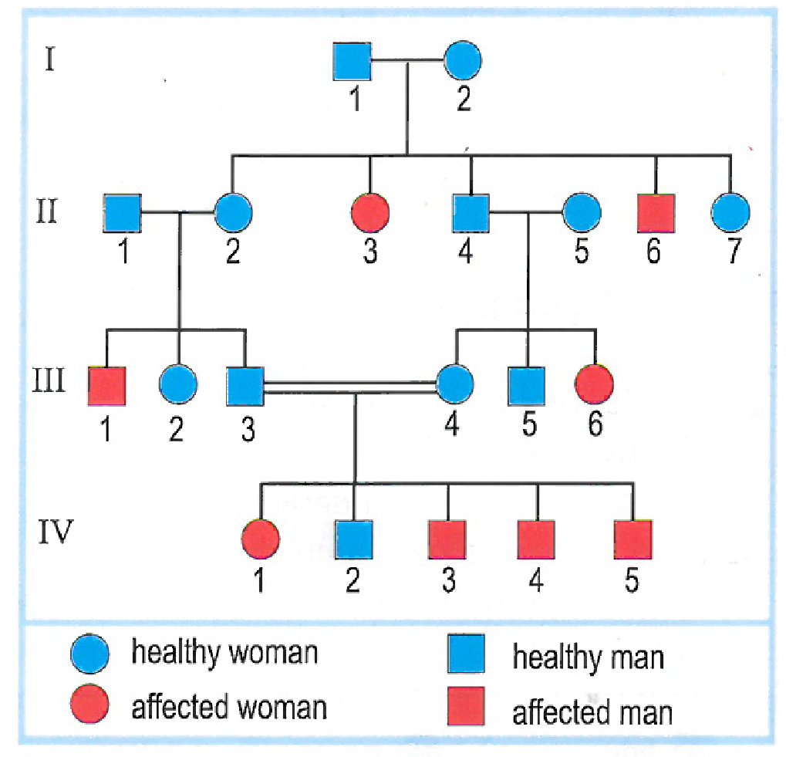
Application 1: Cystic Fibrosis
Specify whether the allele responsible for disease is dominant or recessive.
Determine the locus of gene
Write the genotypes of all individuals in this family. Justify

Slide 18
Recessive, since couple I (1,2) are normal having affected children (II-3 and II-6), then the affected children should have inherited at least one affected allele from one of their parents where it was masked by normal allele.
If the disease was Y-linked (on non-homologous Y) then no females should have been affected which is not the case (II-3) is affected.
If the disease was X-linked (on non homologous X), then female II-3 that is affected should have genotype X^{d}X^{d} where she would have inherited an X^{d} from her father whose genotype should be X^{d}Y then he would be affected but he is normal which is not the case.
If the disease was on homologous XY then the affected girl II-3 genotype should be X^{d}X^{d} she should have inherited an X^{d} from her father (I-1). On the other hand, the affected male II-6 should have genotype X^{d}Y^{d} then he should have inherited Y^{d} from his father. So I-1 genotype should be X^{d}Y^{d} then he should be affected but he is normal which is not the case.
Then the disease is autosomal.

Slide 19
3) Individuals: II(3,6) III(1,6) IV( 1,3,4,5): dd since they are affected and the disease is recessive so they must be pure so the disease is expressed (purity is a characteristic of recessive trait)
I(1-2) II(1-2) II(4-5) III(3-4): Nd since they are normal so they have N allele and have d allele since they have affected children (mention the affected child in exam) which must inherit d allele from them.
II-7, III-2, III-5, IV-2 Nd or NN since they are normal having heterozygous parent.

Slide 20
Calculation genetic risk- autosomal recessive
In order to calculate the risk for an embryo to be affected, we should know the conditions that are necessary to obtain affected child
In case of autosomal recessive disease:
Father should be heterozygous or affected
Child should receive affected allele from his father
Mother should be heterozygous or affected
Child should receive affected allele from his mother

Slide 21
A and C: Parent to be heterozygous (father or mother)
case
value
If he is surely Nd. How? From pedigree:
He has affected son
Or he has affected parent
Using DNA finger print if present
1
If he is affected (dd)
1
If he is surely NN
0
If he is normal, with normal parents and affected sibling (brother or sister)
2/3
No family history, probability of being hybrid is given in text
P

Slide 22
B and D: P child receive d allele from his parent (father or mother)
case
value
If parent is affected
1
If parent is normal and not NN
1/2

Slide 23
Application 2:
For each of the following 4 cases, calculate the risk for the couple to a child affected with cystic fibrosis, given that in the population where the family lives, the probability of person to be heterozygous is 1/20
Case 1
Case 2
Case 3
Case 4
No family history for both parents
One of parents have family history
Both parents have family history
Parents have diseased child

Slide 24
Case 1:
Probability for mother to be hetero: 1/20 (no family history)
Probability for father to be heterozygous: 1/20 (no family history)
Probability to have affected child if parents were heterozygous:
Risk= 1/20 x 1/20 x ¼= 1/1600
 | N ½ | d 1/2
N 1/2 | NN | Nd
d 1/2 | Nd | dd 1/4

Slide 25
Case 2:
Probability of father to be heterozygous: 1/20 (no family history)
Probability of mother to be heterozygous: 2/3 since she is normal having normal parents and affected sibling
Probability of couple to have affected child if they were heterozygous: ¼ (Punnett square)
Risk= 1/20 x 2/3 x ¼ =1/120

Slide 26
Case 3:
Probability of mother and father to be heterozygous: 2/3 (since she/he is normal having normal parents and affected sibling)
Probability of couple to have affected child if they were heterozygous: ¼
Risk= 2/3 x 2/3 x ¼ = 1/9
Case 4:
The parents are normal and have affected child so their genotype is Nd since the child must inherit each d allele from one of his parents.
Father hetero: 1/1
Mother hetero: 1/1
Having affected child: ¼
Risk: 1/1 x 1/1 x ¼= 1/4

Slide 27
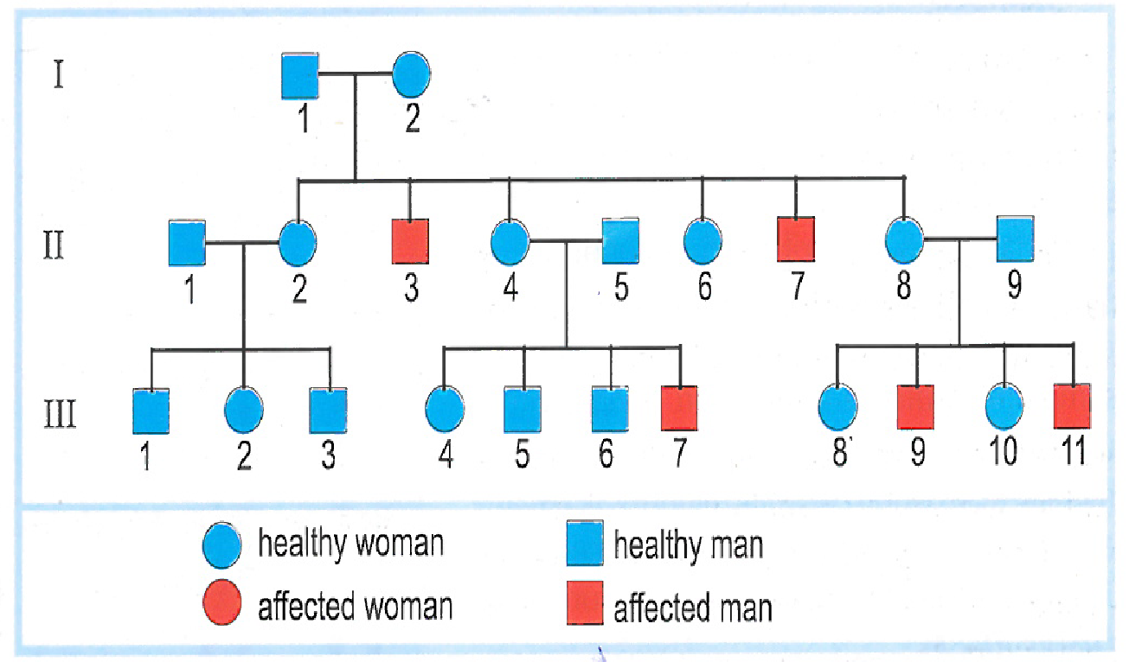
Application 3: Duchene muscular dystrophy (DMD)
Specify whether the allele responsible for disease is dominant or recessive.
Determine the locus of gene
Write the genotypes of all individuals in this family. Justify

Slide 28
Since parents I-1 and I-2 are normal and have affected children II-3 and II-7 then they must at least inherit one affected allele from of their parents where it was masked by the normal allele so it is recessive
Since only males are affected then the disease must be sex linked (neither autosomal nor on homologous XY).
If the disease is Y linked then the affected boy II-3 should have affected father (XY^{d} should inherit Y^{d} from his father who should be affected). So the disease is X linked.

Slide 29
3) I-1, II-1 II-5 II-9 III-1 III-5 III-6: X^{N}Y since the disease is X linked and in this case the phenotype of male reveals his genotype where the only allele he has will be expressed so these individuals must have an N allele on X.
II-3 II-7 III-7 III-9 III-11 X^{d}Y (same justification above) must have d allele
I-2 II-4 II-8: X^{N}X^{d} since they are healthy females so they have N allele and hey have affected boys who inherited their X^{d} from their mother so they should be heterozygous.
II-6 II-2 III-2 III-4 III-8 III-10: X^{N}X^{N} or X^{N}X^{d} since they are healthy and each of them has a heterozygous mother so they can be homozygous or heterozygous

Slide 30
Important Note Regarding X-linked recessive disease.
Regarding X linked recessive disease: a normal male should have all his girls normal since they inherit X^{N} from him. If a normal male has an affected female then the female did not inherit X^{N} from him then this female has monosomy X (turner syndrome) where she inherit X^{d} from her mother. That is because a non disjunction of chromosomes during meiosis in father that results in gamete without sex chromosome. This gamete fertilizes a mother gamete having X^{d} sex chromosome so the daughter would have X^{d} only so she would be affected.

Slide 31
Calculation of risk- X-linked Recessive
case
value
Father is always heterozygous since he has X and Y which are not homologous chromosome.
Male’s Phenotype reveals his genotype X^{N}Y or X^{d}Y
Father
1
If she is affected X^{d}X^{d}
1
If she is surely X^{N}X^{N}
0
If she is normal, with normal parents and affected brother
mother
½ (prove by Punnett square)
No family history, probability of being hybrid is given in text
P

Slide 32
Refer to pedigree of DMD: Determine the risk of couple (II-1, II-2) to give birth to affected child:
If the child’s gender is unknown
If the child is male
If the child is female

Slide 33
II-1: X^{N}Y since he is normal and the disease is X-linked so the phenotype of male reveals his genotype
II-2: probability to be X^{N}X^{d} = ½ since she is normal female having normal parents and affected brother who should have inherited X^{d} from his mother who should be X^{N}X^{d}.
Probability of having affected child: according to punnett square
If gender is unknown: 1/4
Among males: ½
Among females: nil (since they should inherit X^{N} from their father so all females are normal)
 | X^{N} 1/2 | X^{d} 1/2
X^{N}1/2 | X^{N}X^{N} | X^{N}X^{d}
Y 1/2 | X^{N}Y | X^{d}Y
 | X^{N} 1/2 | X^{d} 1/2
X^{N}1/2 | X^{N}X^{N} 1/4 | X^{N}X^{d} 1/4
Y 1/2 | X^{N}Y 1/4 | X^{d}Y 1/4

Slide 34
Determination of gene location if Disease is Dominant

Slide 35
If disease is dominant (X-linked characteristics and denying)
Characteristic
How to Deny
Look for normal father and affected daughter
Affected father has all his daughters affected!
Affected son should have affected mother
Normal mother should have all her sons normal.
Daughter is normal should be X^{n} X^{n} should inherit X^{n} from her father whose genotype should be X^{n}Y who should be normal which is not the case
X linked
Look for affected mother and normal son
mother is normal should be X^{n}X^{n} should give her son X^{n} whose genotype should be X^{n}Y who should be normal which is not the case

Slide 36
If disease is dominant (Y-linked characteristics and denying)
Characteristic
How to Deny
Look for normal father and affected son
If the gene was located on non homologous Y chromosome then son II-1 genotype should be XY^{d} he should have inherited Y^{d} from his father (I-1) who should be also XY^{d} and must be affected which is not the case
Every affected father should have all his sons affected
No females should be affected
Look for affected father and normal son
Y linked
If the gene was located on non homologous Y chromosome then son II-1 genotype should be XY^{d} he should have inherited Y^{d} from his father who should be also XY^{d} and must be affected which is not the case
Look for affected girl
If the gene was located on non homologous Y then no girls should be affected but girl II-1 is affected which is not the case

Slide 37
If disease is dominant (Homologous X and Y characteristics and denying)
Characteristic
How to Deny
Look for normal father and affected son + daughter
Every affected brother and sister should have affected father
If the gene was located on homologous part of X and Y then child II-1 who is normal her genotype should be X^{n}X^{n} should have inherited X^{n} from her father, and the son II-2 who is normal, his genotype should be X^{n}Y^{n} then he should inherit Y^{n} from his father, so father’s genotype should be X^{n}Y^{n} and must be normal which is not the case
Homologous X and Y
Look for grand father, son, grand son with different phenotypes and the mother with recessive phenotype
Mother II 2 is normal so she must be X^{n}X^{n} she should give her son (IIII-1) X^{n} so he must be X^{n}Y^{D} since he is affected, he must inherit Y^{D} from his father and by his turn from his grand father (I-1) who must be affected which is not the case

Slide 38
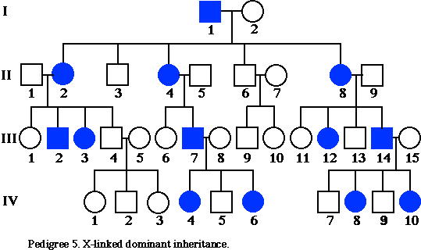
If disease is dominant (Autosomal characteristics and denying)
Characteristic
How to Deny
By depending on X- linked dominant trait characteristics
Males and females could be affected equally
If the phenotypes of parents were inverted, there shouldn’t be any variation in distribution of disease among males and females of children
Since each affected father has all his daughters affected!
And each affected son have affected mother
And each normal mother have all her sons normal then it is sex linked
Homologous X and Y
Or: (better) Affected father and normal mother have only their daughters affected (example couple I 1-2 and couple III 14-15) and no boys affected while the opposite phenotypes (normal father and affected mother) shows the possibility of presence of both daughter or sons to be affected equally (coule II: 1-2 and couple II 8-9) then the disease is X- linked

Slide 39
Sum up: If disease is dominant
Homologous X and Y
X linked
Y linked
Affected father has all his daughters affected!
Affected son should have affected mother
Every affected girl should have affected father
Every normal boy should have normal mother
Every normal brother and sister should have normal father
Characteristic
Look for normal father and affected daughter
If the gene was located on non homologous Y chromosome then son II-1 genotype should be XY^{D} he should have inherited Y^{D} from his father (I-1) who should be also XY^{D} and must be affected which is not the case
Daughter is normal should be X^{n} X^{n} should inherit X^{n} from her father whose genotype should be X^{n}Y who should be normal which is not the case
If the gene was located on homologous part of X and Y then child II-1 who is normal her genotype should be X^{n}X^{n} should have inherited X^{n} from her father, and the son II-2 who is normal, his genotype should be X^{n}Y^{n} then he should inherit Y^{n} from his father, so father’s genotype should be X^{n}Y^{n} and must be normal which is not the case
How to Deny
If the gene was located on non homologous Y chromosome then son II-1 genotype should be XY^{D} he should have inherited Y^{D} from his father who should be also XY^{D} and must be affected which is not the case
Look for affected mother and normal son
mother is normal should be X^{n}X^{n} should give her son X^{n} whose genotype should be X^{n}Y who should be normal which is not the case
If the gene was located on non homologous Y then no girls should be affected but girl II-1 is affected which is not the case.

Slide 40
Gene Location: Concept map for way of thinking
recessive
dominant
Normal father with affected brother and sister
Only males are affected
affected father with normal brother and sister
grand father, son, grand son with different phenotypes and the mother with recessive phenotype
Affected father has all his daughters affected!
Affected son should have affected mother
Normal mother should have all her sons normal.
autosomal
X- linked
autosomal
autosomal
X- linked

Slide 41
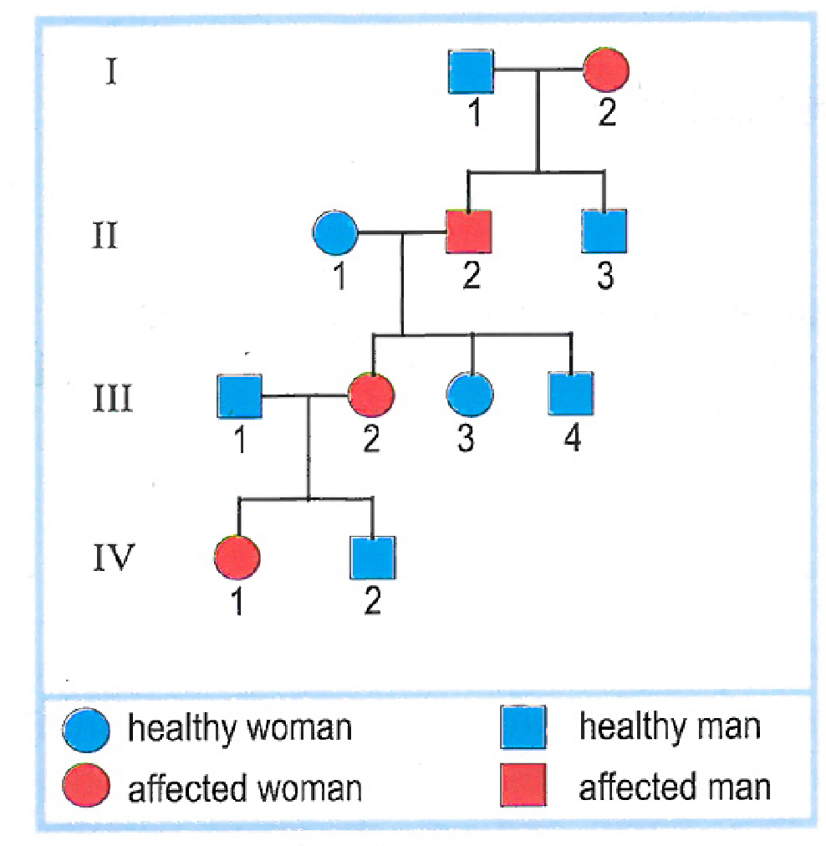
Huntington Chorea
Specify whether the allele responsible for disease is dominant or recessive.
Determine the locus of gene
Write the genotypes of all individuals in this family. Justify

Slide 42
Dominant, since the disease exist in every generation and every affected child has at least one affected parent so it cant be masked.
2)
If the disease was located on non homologous Y (Y-linked) then no females should be affected but I-2 III-2 IV-1 are affected females which is not the case.
Or boy II-2 is affected should have genotype XY^{D} who should inherit Y^{D} from his father who should be affected (XY^{D}) which is not the case
If the disease was located on non homologous part of X then affected girl III-3 genotype should be X^{n}X^{n} should inherit X^{n} from her father who should be X^{n}Y then he should be normal which is not the case
If the disease is located on the homologous part of XY then III-3 affected girl III-3 genotype should be X^{n}X^{n} who should inherit X^{n} from her father. On the other hand affected boy III-4 genotype should be X^{n}Y^{n} who should inherit Y^{n} from his father then the father II-2 should be normal which is not the case
Then disease is autosomal

Slide 43
3) I-1, II-1 III-3 III-4 IV-2: nn since they are healthy and normal allele is recessive and expressed only in homozygous state.
I-2 II-2 III-2: Dn since they are affected and they have healthy children who must have inherited normal allele from both parents who must be carrier of normal allele.
IV-1 Dn: since he is affected by father III-1 is normal so he must have inherited normal allele from his father.

Slide 44
Calculation of risk- Autosomal Dominant
Two methods:
1st method: Sum of the risk of the different possible ways to get affected child
2nd method: Risk = 1- probability to be normal

Slide 45
Case 1
Case 2
Case 3
I
II
III
IV

Slide 46
Case1 :
II-1: Dn (1/1) since she is affected and have normal mother should inherit n allele from her.
II-2: Dn (same as above)
To have normal son if they were heterozygous (1/4) (Punnett square)
Risk=1-1/4=3/4
Case 2:
I-1 (mother): nn (1/1) since she is normal so she should be pure (purity is characteristic of recessive trait.
I-2: Dn (1/1) since she is affected having normal daughter who should have inherit n allele from him
To have normal son: ½ (Punnett square)
Risk=1-1/2=1/2

Slide 47
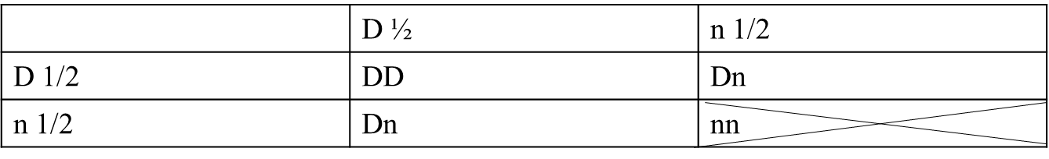
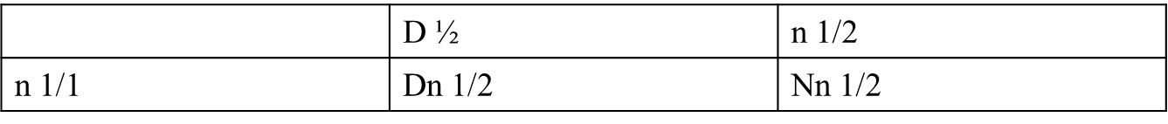
Case 3:
Mother III-2: nn 1/1 since she is normal so she must be pure since normal is recessive trait.
Father III-2: In order the fetus IV-1 to be normal the father should be heterozygous Dn.
Probability of III-2 to be heterozygous.
III-2 parents (II-1 and II-2) are Dn for sure since they are affected and each of them have one normal parent (I-1 and I-4) so they must be carrier of normal allele.
According to Punnett square for these couple to have heterozygous child: 2/3
Probability to have normal child in this case (Punnett square): ½
Probability to have normal child: 1 x 2/3 x ½ = 1/3.
Risk of having affected child: 1- Probability to be normal = 1-1/3=2/3

Slide 48
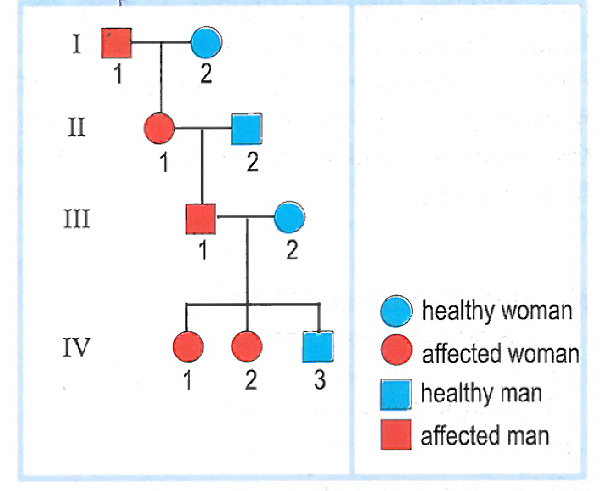
Vitamin- Resistant Rickets
Specify whether the allele responsible for disease is dominant or recessive.
Determine the locus of gene
Write the genotypes of all individuals in this family. Justify

Slide 49
Since disease appears in every generation and every affected child has at least one affected parent then the disease can’t be masked so it is dominant
Since each affected father(III-1) has all his daughters affected (IV-1 IV-2) and no affected boys(IV-3), while affected mother and normal father (II-1 and II-2) has affected boy (III-1) then the disease is X linked.
II-2 and IV-3: X^{n}Y since the disease is X linked and in this case the phenotype of males reveals their genotype since the only allele they has will be expressed which is normal.
I-1 and III-1: X^{D}Y same justification above.
I-2 and III-2: X^{n}X^{n} because they are healthy females and normal allele is recessive so it must be homozygous to be expressed.
II-1, IV-1, IV-2 (X^{D}X^{n}) because they are affected so the have D allele but since their mothers are healthy so they must inherit the n allele from her so they should be heterozygous.

Slide 50
Document 4: Chromosomal abnormalities
Definition: Change in number or structure of chromosomes
Chromosomal Abnormalities
Numerical Abnormalities
Structural Abnormalities
Trisomy
Free trisomy
Linked trisomy
Monosomy
Deletion
Insertion
Inversion
Translocation

Slide 51
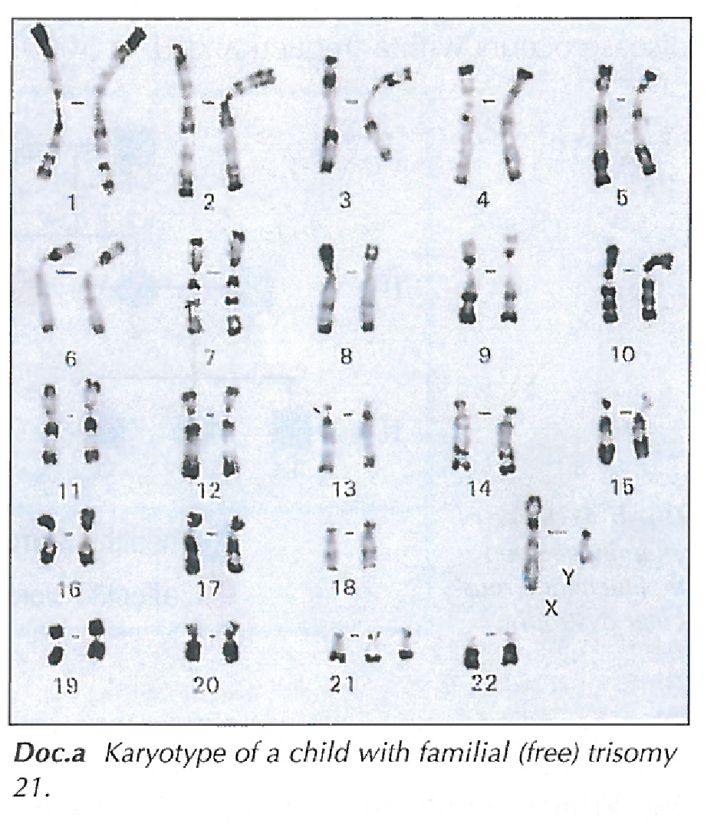
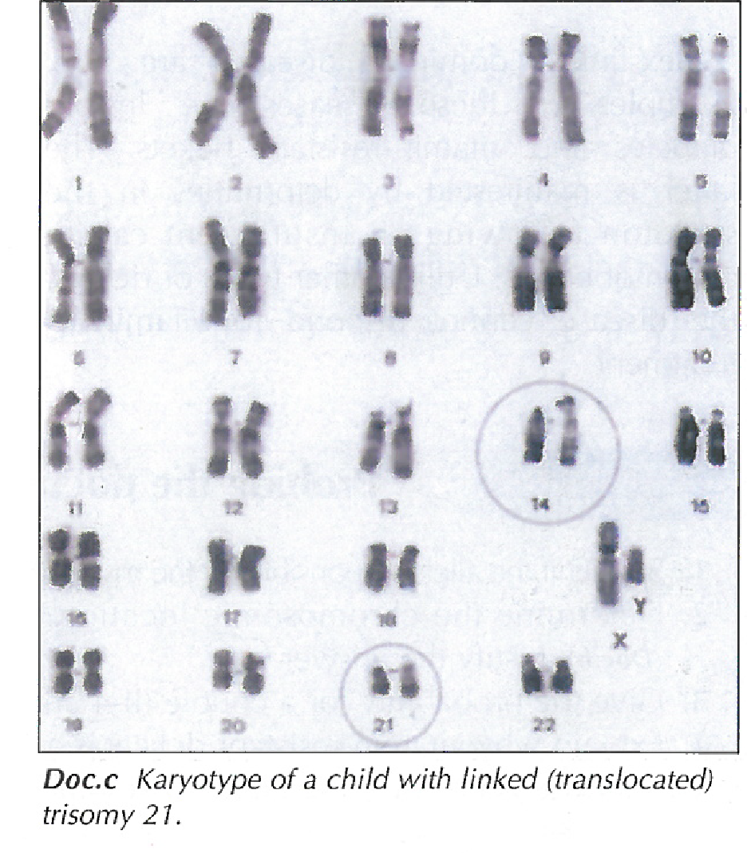
Numerical Abnormalities
Write the chromosomal formula for karyotype (a)
Compare both karyotypes
What can you deduce knowing that child of karyotype (c) shows same symptoms as child of karyotype (a)
Write the chromosomal formula of karyotype (c)
Name the type of abnormality in each case.
What is the origin of each abnormality

Slide 52
Answer:
Chromosomal formula of karyotype (a): 47, XY, +21
The total number of chromosome in karyotype (a) is 47 more than that of (c) (46). Moreover, al chromosomes exist in pairs in karyotype (a) where each pair have same size except chromosome 21 where it exist as 3 in karyotype (a). However in karyotype (c) all chromosomes exist in pairs with equal sizes except chromosome 14 where on chromosome is larger than the other and larger of chromosome 14 of karyotype (a). In addition both karyotypes have same number and type of gonosomes (X and Y).
The karyotype of the 1st child shows that he has extra genetic information (extra chromosome 21) then this child is abnormal suffering from trisomy 21 (down syndrome). Since the 2nd child suffers from the same symptoms as the 1st one then he has extra genetic information (of same chromosome as 1st child that is chromosome 21) And since the karyotype shows one longer chromosome 14, then this is due to presence of extra chromosome 21 linked to chromosome 14. Therefore the 2nd child suffer from trisomy 21 due to translocation (linked trisomy 21)
Karyotype (c): 46, XY, t(21,14)
Disorder in (a): free trisomy 21 Disorder in (c): linked trisomy 21
Free trisomy 21: due to non disjunction of chromosome during meiosis linked trisomy 21: due to transloaction

Slide 53
Examples of numerical abnormalities
Down syndrome: Trisomy 21: 47, XX, +21 Or 47, XY, +21
Klinefilter syndrome: 47, XXY.
Sterile due to atrophy in testes
Turner’s Syndrome: 45, X
Sterile due to atrophy in ovaries.

Slide 54
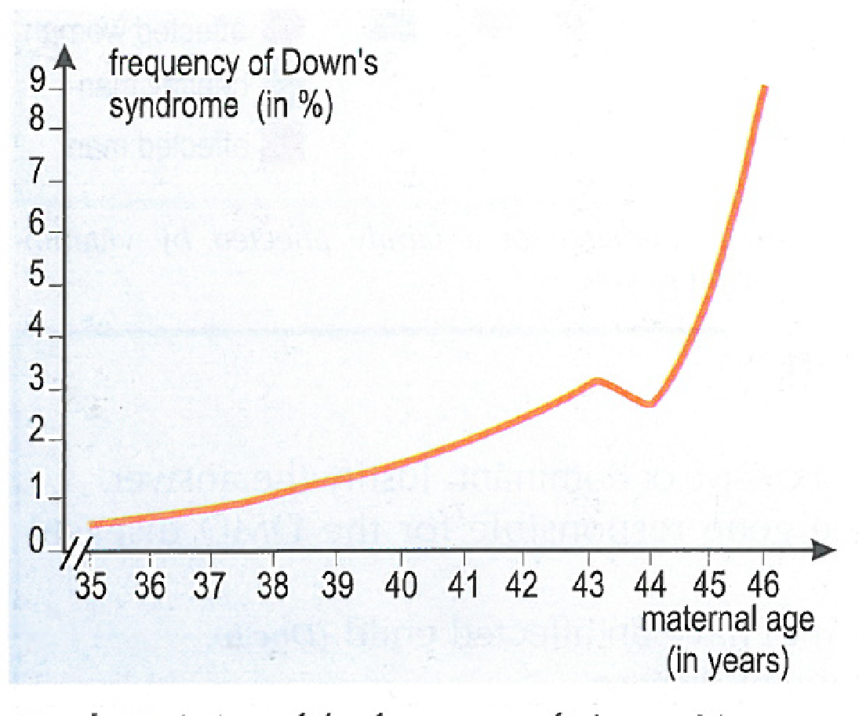
Effect of maternal age of pregnancy on frequency of Down syndrome
Interpret the adjacent graph.

Slide 55
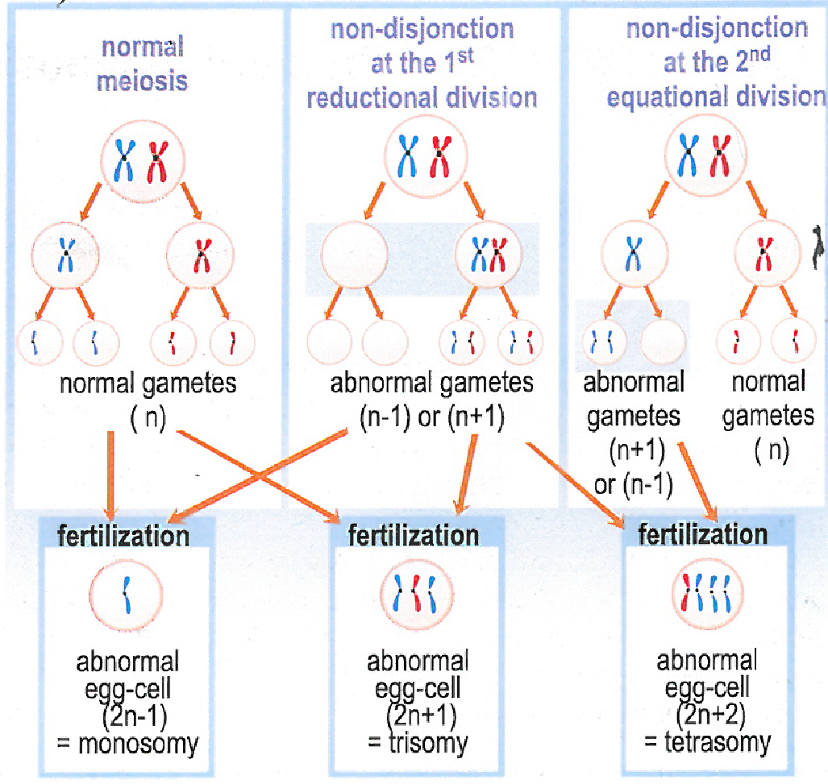
Cause of numerical abnormalities: Non-disjunction of chromosomes
A
B
The fertilization of normal gamete having one copy of chromosome with other gamete having:
2 copies of same chromosome leads to trisomy
Lack of copy of chromosome leads to monosomy
The formation of gametes with abnormal number of chromosomes (2 copies of same chromosome or lack of copy of chromosome) is due to non disjunction of chromosomes:
Non disjunction of homologous chromosomes during anaphase I (A)
Non disjunction of sister chromatids during anaphase II (B)

Slide 56
Number 4 p:100

Slide 57
Structural mutations
Translocation
Complete Translocation
Complete chromosome is translocated it other chromosome
Partial Translocation: segment of chromosome is translocated to other one
21
5
14
14
21
14
14
5
5
Deletion:
A segment of chromosome is deleted

Slide 58
Examples of structural mutations
Chrom 2
Chrom 22
Normal
Chromosomes 2 and 22 exist in pair, the chromosomes of each pair have same size but in pair 22 one is shorter than the other. Therefore the type of mutations is deletion because there is loss of a fragment of chromosome 22.
Phenotype is abnormal since there is loss of genetic material
Person 1
Chromosomes 2 and 22 exist in pair, the chromosomes of each pair have different size where in pair 2 one is abnormally longer while in pair 22 one is abnormally shorter . Therefore the type of mutation is balanced translocation of a fragment of chromosome 22 onto chromosome 2 because fragment of chromosome 22 is attached on ch 2
Phenotype is normal since there is no loss or gain of genetic material because translocation is balanced
Person 2
In pair 2 the hromosomes exist in pairs where one is abnormally longer while in pair 22 there is only 1 chromosome instead of 2. Therefore there is balanced translocation where chromosome 22 is attached to chromosome 2.
Phenotype is normal: there is no loss or gain in genetic material
Person 3

Slide 59
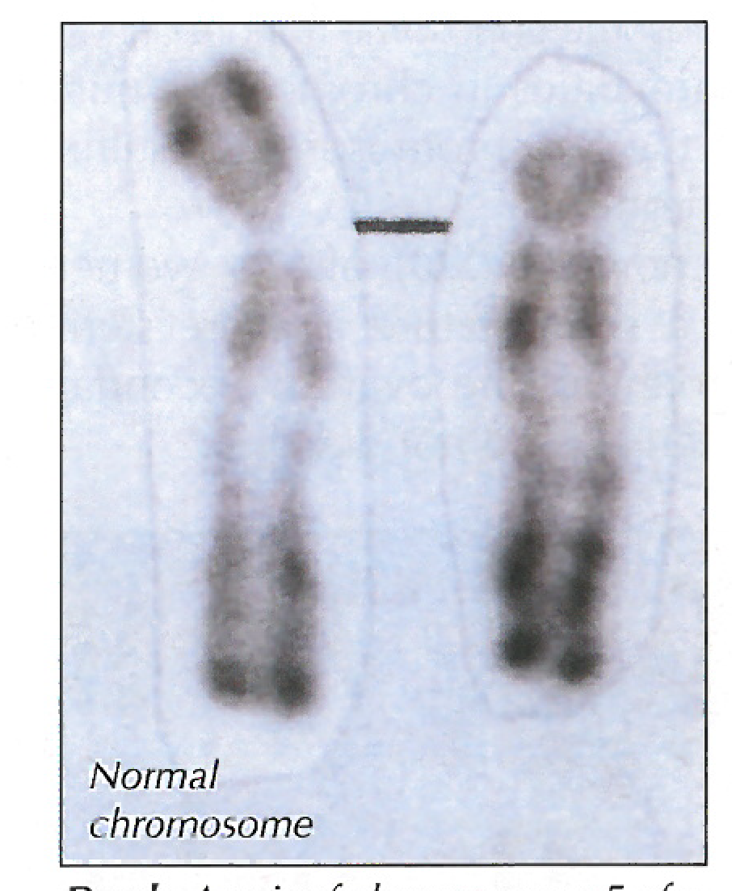
Cat Cry Syndrome
Cause: Deletion of fragment of the short arm of chromosome number 5 that appears shorter
1) Write the gametes produced by person affected with cat-cry syndrome and hose of a normal one, then give the result of fertilization of these gametes

Slide 60
Document 5: Prenatal Diagnosis
Introduction: The presence of genetic disorder in a family is an indication for a couple to consult physician who asks for specific tests to predict the risks.
What are these tests?
When and how are performed

Slide 61
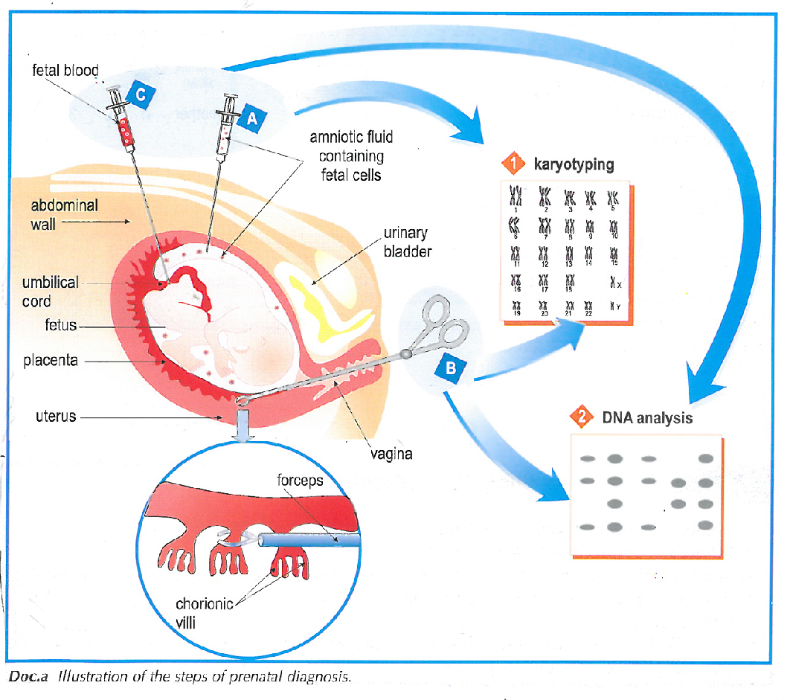
Methods used in prenatal diagnosis and analysis
Tests done for prenatal diagnosis necessitates 2 steps:
I: blood sampling
II: Analysis
I: Blood sampling could be by:
Amniocentesis: cells taken from amniotic fluid (16th week)
Chorionic villus biopsy (8th week)
Sampling of fetal bood (20th week)
II: Analysis could be by:
karyotype
DNA fingerprint

